Slide 1

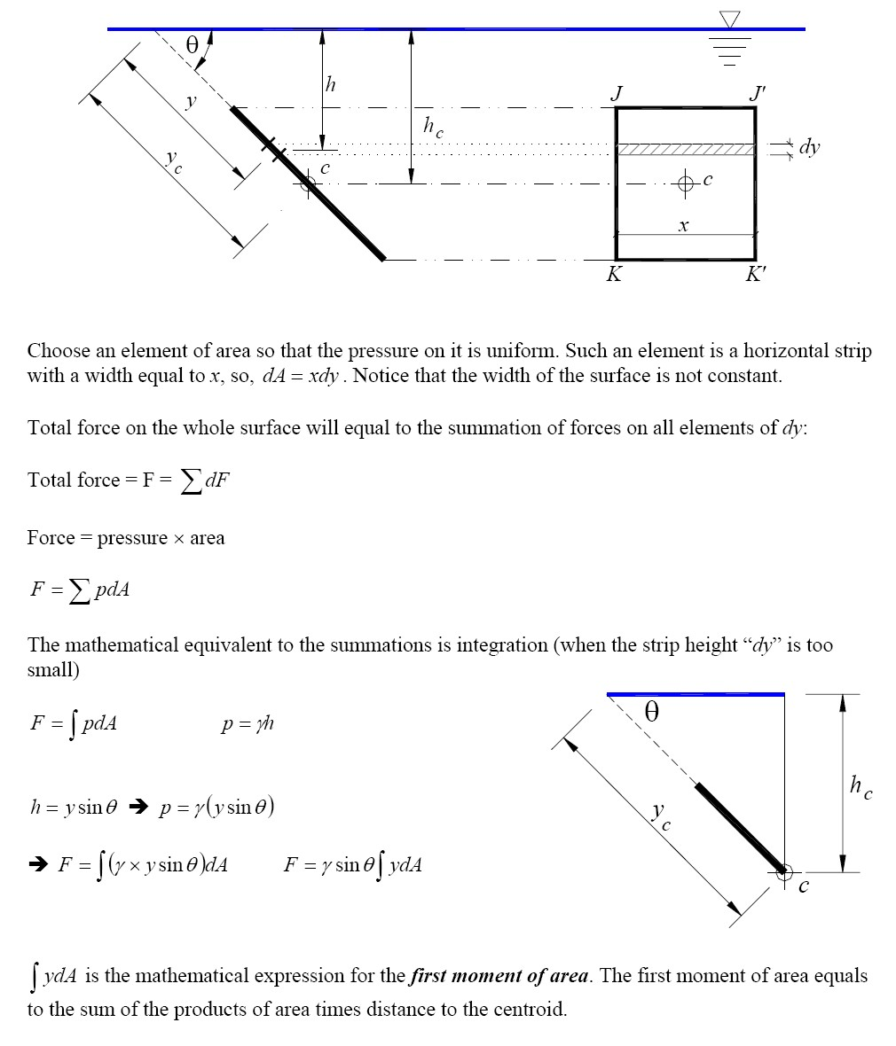
Fluid Mechanics Class Note
Dr. Qassem Hamed Jalut Associate Professor

Slide 2
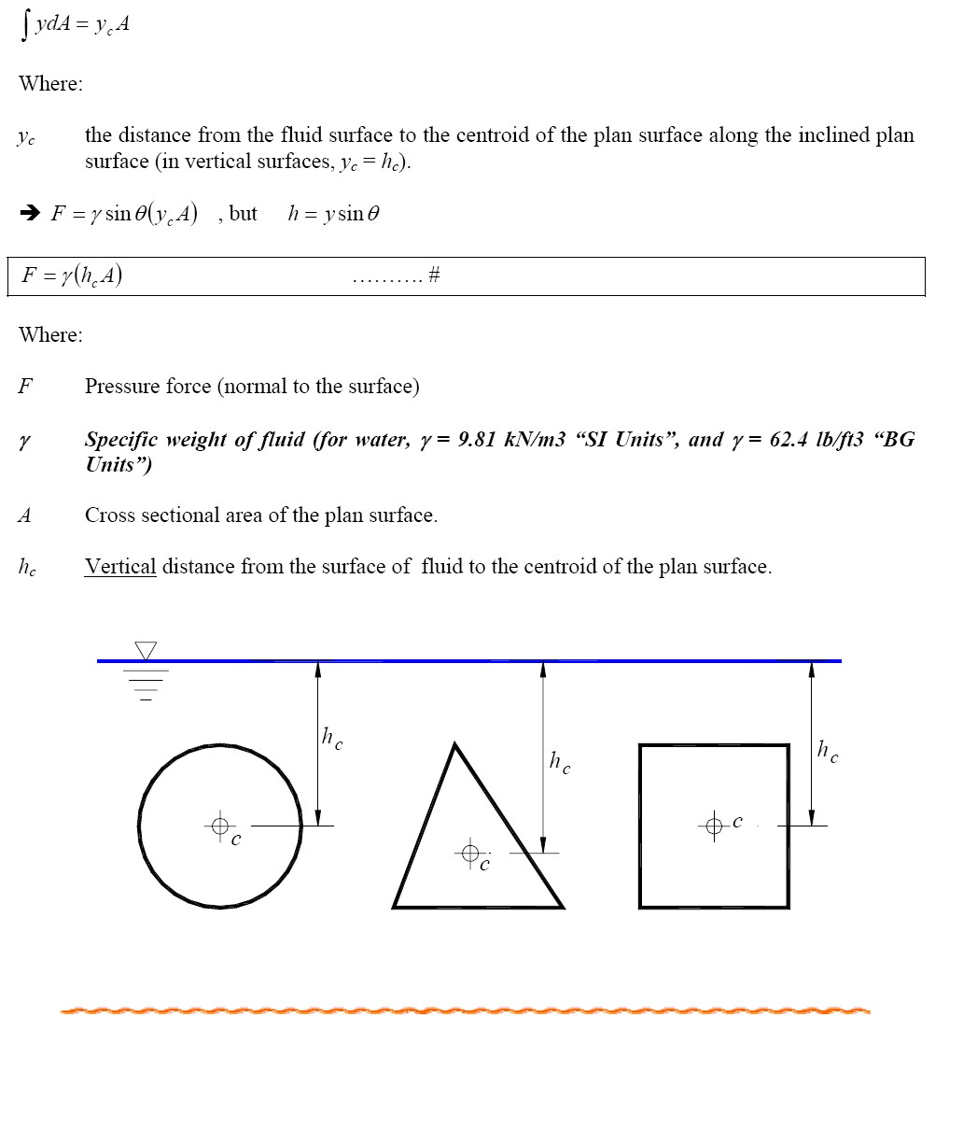
Fluid Mechanics Class Note
Dr. Qassem Hamed Jalut Associate Professor

Slide 3
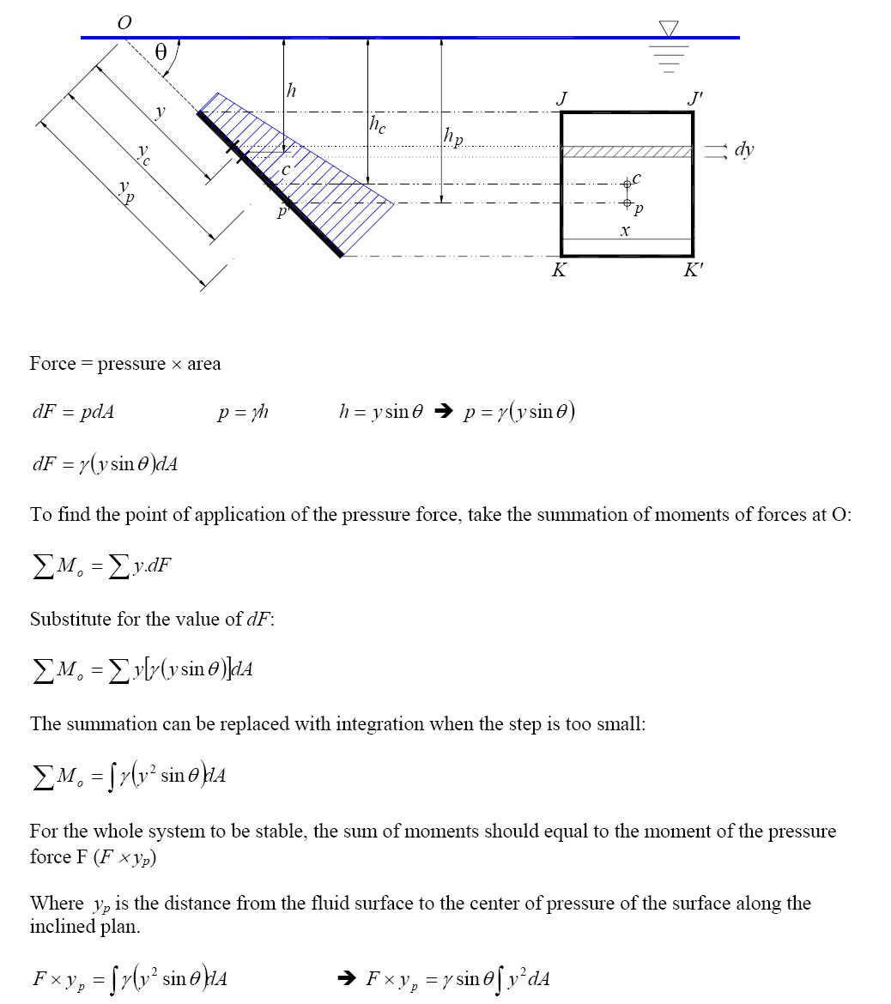
Fluid Mechanics Class Note
Dr. Qassem Hamed Jalut Associate Professor

Slide 4
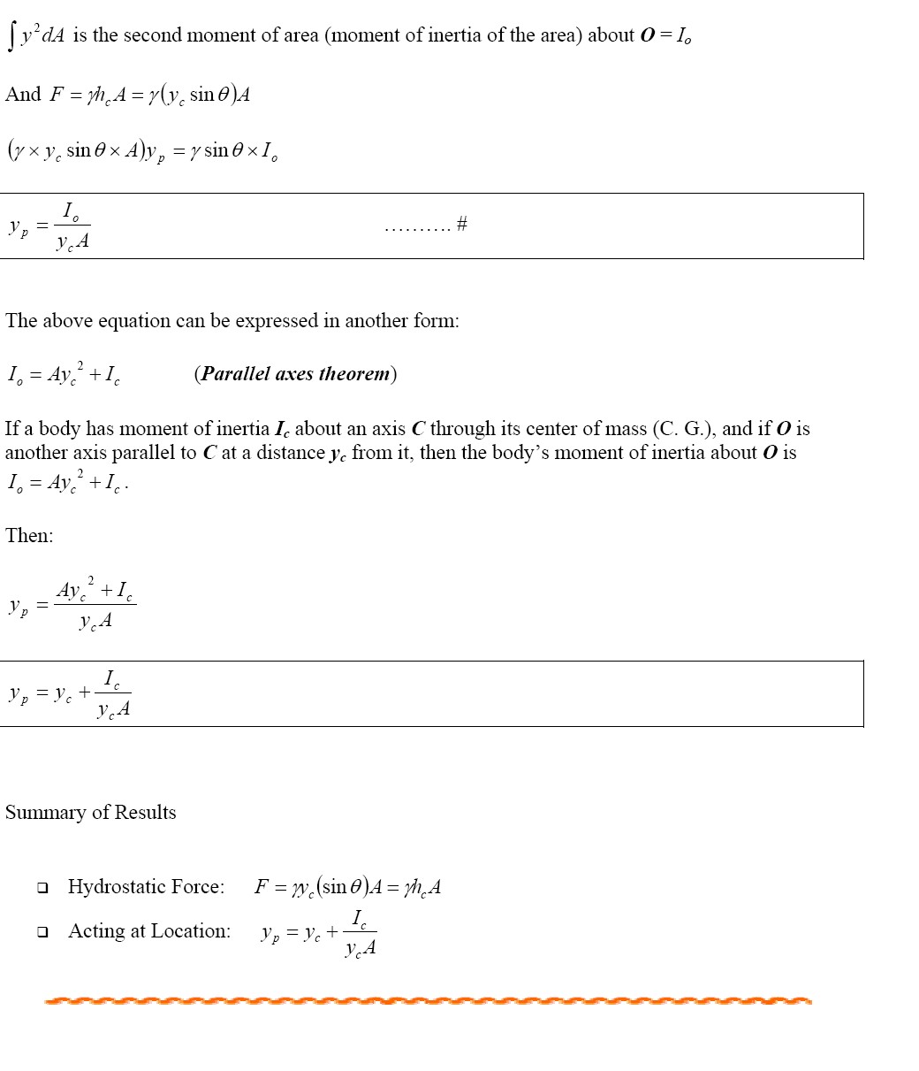
Fluid Mechanics Class Note
Dr. Qassem Hamed Jalut Associate Professor

Slide 5
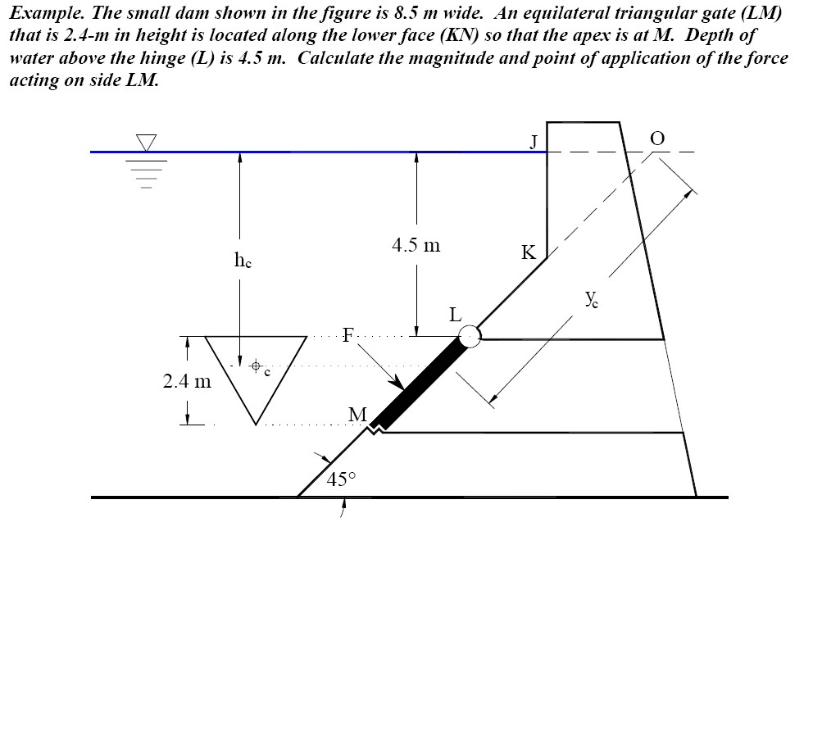
Fluid Mechanics Class Note
Dr. Qassem Hamed Jalut Associate Professor

Slide 6
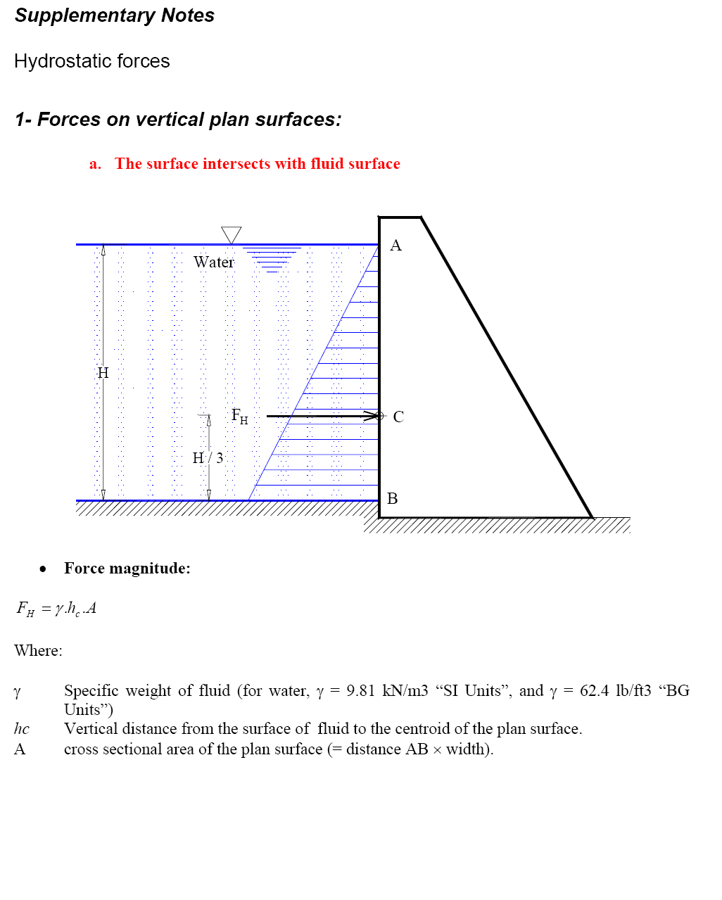
Fluid Mechanics Class Note
Dr. Qassem Hamed Jalut Associate Professor
50

Slide 7
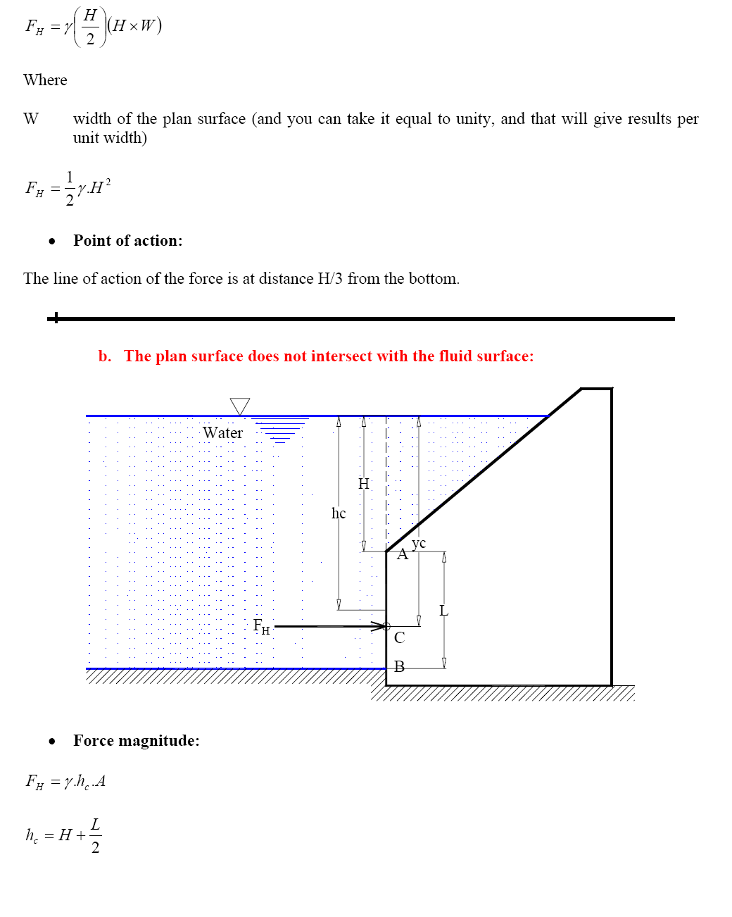
Fluid Mechanics Class Note
Dr. Qassem Hamed Jalut Associate Professor

Slide 8
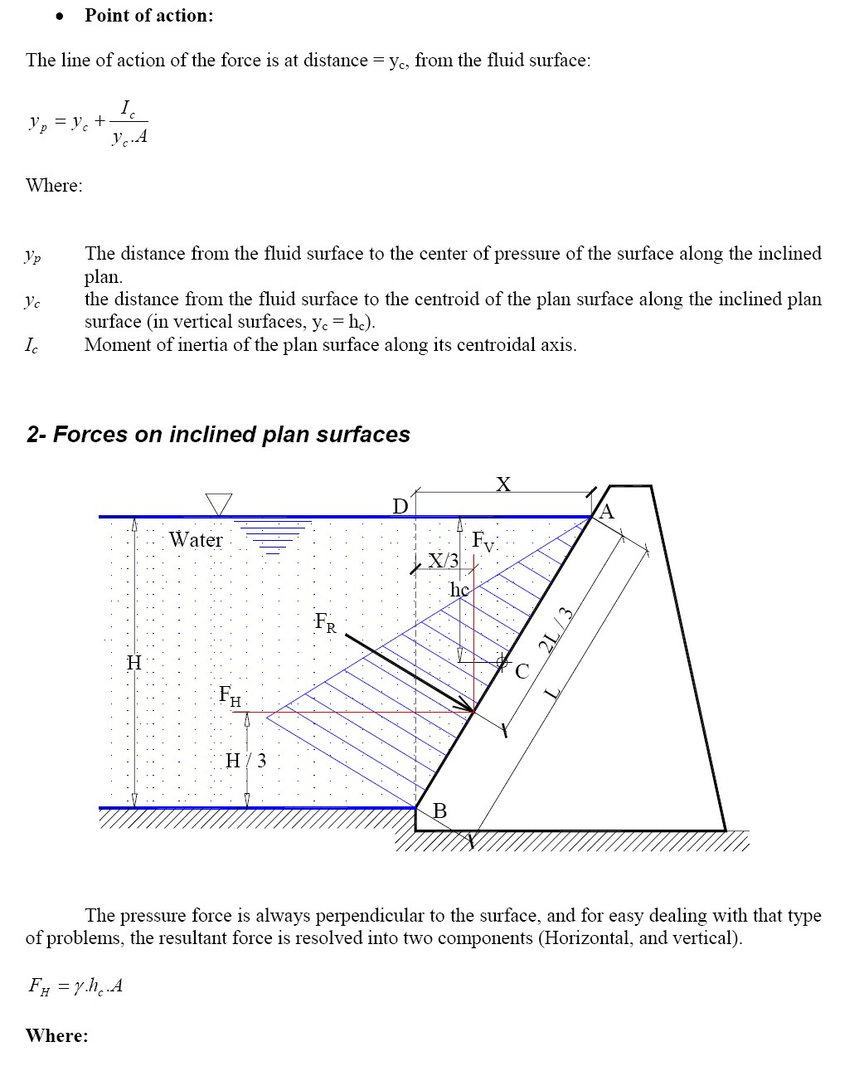
Fluid Mechanics Class Note
Dr. Qassem Hamed Jalut Associate Professor

Slide 9
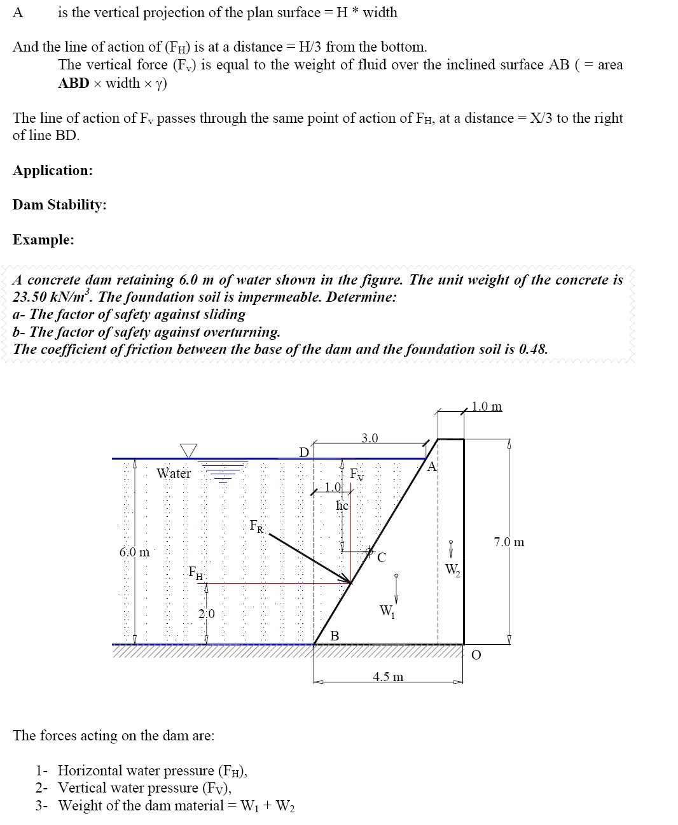
Fluid Mechanics Class Note
Dr. Qassem Hamed Jalut Associate Professor

Slide 10
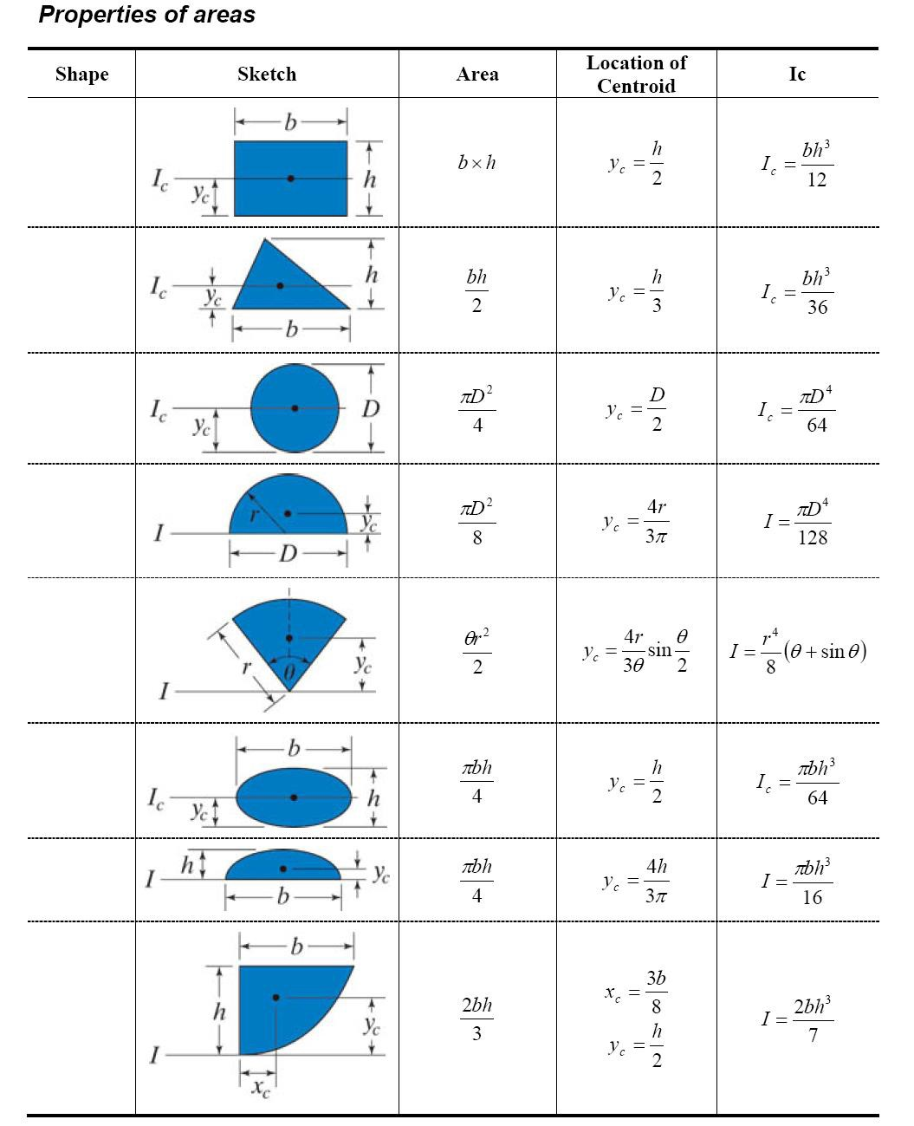
Fluid Mechanics Class Note
Dr. Qassem Hamed Jalut Associate Professor

Slide 11

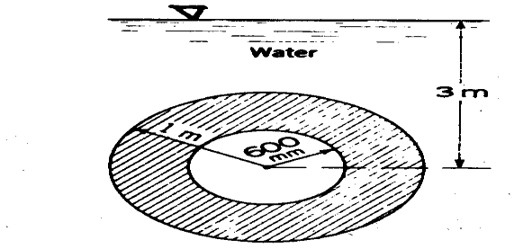
Fluid Mechanics Class Note
Dr. Qassem Hamed Jalut Associate Professor
Problems:
Problem (1)
The gate shown is 3.0 wide. Find the value of the weight required for the gate to be in equilibrium.
W
water 4 m
5 m
60º
Problem (2) Find the force exerted by water on one side of the vertical annular disk shown below. Also calculate the center of pressure.

Slide 12
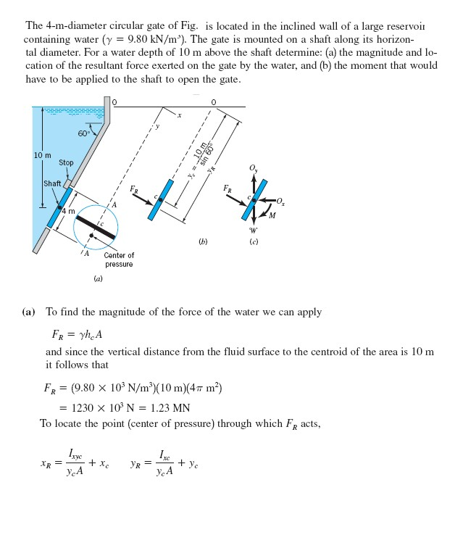
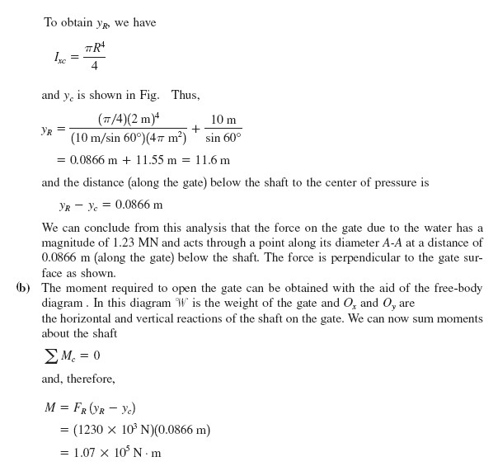
Fluid Mechanics Class Note
Dr. Qassem Hamed Jalut Associate Professor
Example (1)

Slide 13
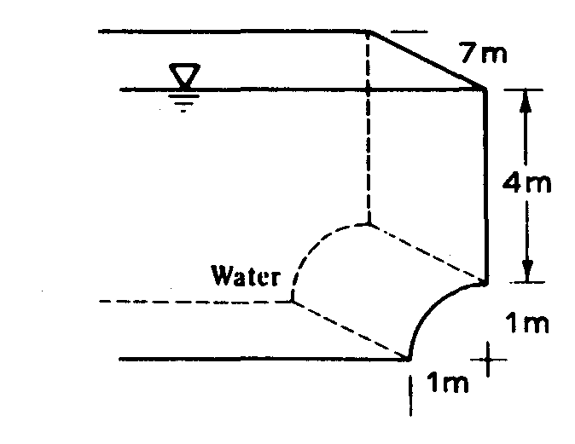
Fluid Mechanics Class Note
Dr. Qassem Hamed Jalut Associate Professor
Problem (3)
Compute the horizontal and vertical components of the hydrostatic force on the quarter-circle face of the tank shown below.

